Slide 1
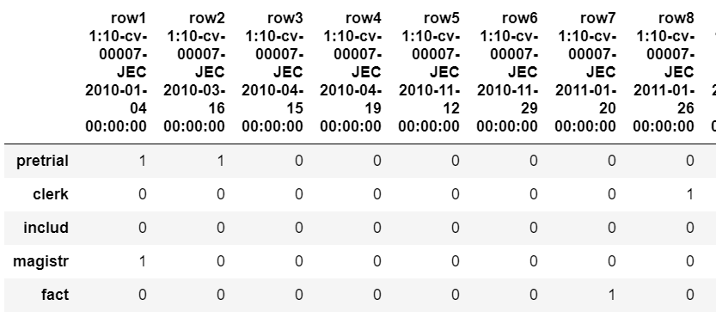
Algorithm - Overview
1
4 STEPS TO MAKING OUR PREDICTION
Step1: Create a frequency distribution of key words by life cycle stage
Step2: Identify those key words that are most likely to differentiate one stage from the others.
Step3: Once selected, create a table that shows the appearance of the key words in each docket sheet entry.
Step4: Generate predictions using various machine learning algorithms.
2
3

Slide 2
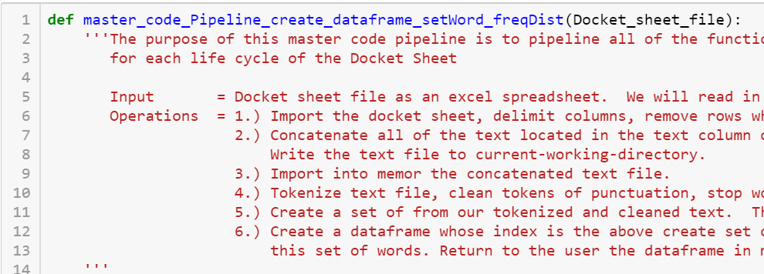
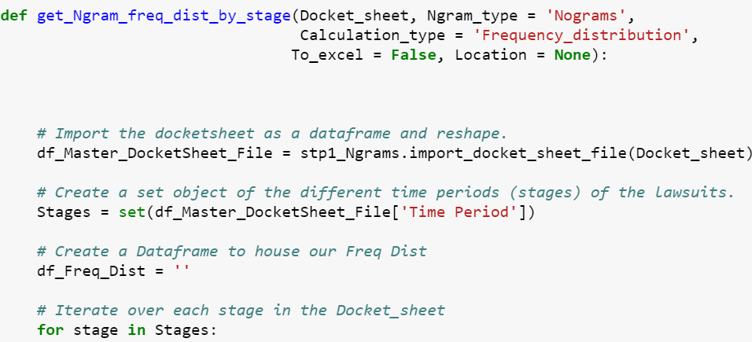
Step 1 - Updates
Version 1.0
Single words
Appearance versus frequency
Several minutes to generate a frequency distribution for all stages.
Version 2.0
Code is now modular.
Nograms, Bigrams, Trigrams, Quadgrams
*larger ngrams should result in more unique patterns
Both the appearance and frequency of Ngrmas
Several seconds to generate a single frequency distribution. Less than a minute for all combinations.

Slide 3
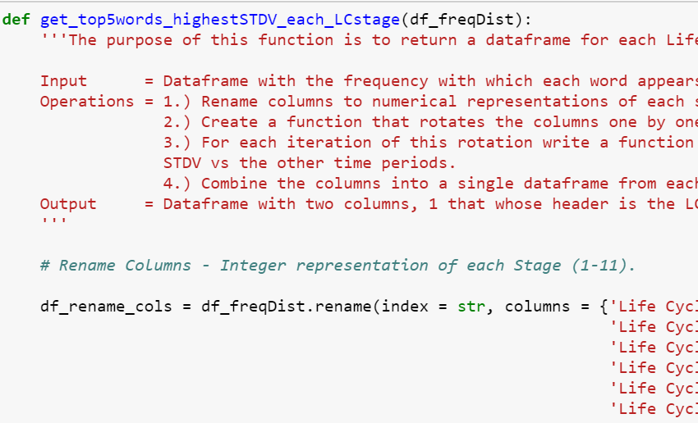
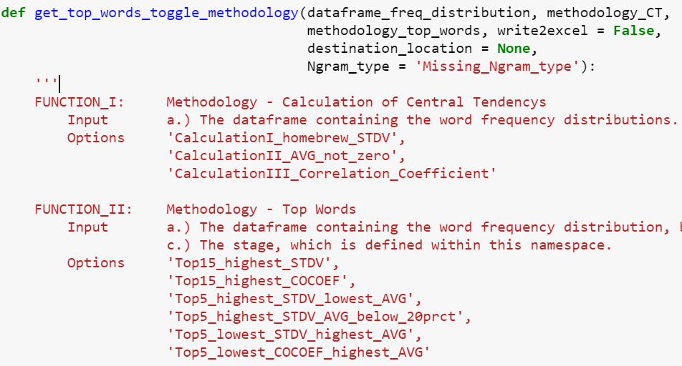
Step 2 - Updates
Version 1.0
Identify key words using a single calculation for STDV
A single threshold for the average for the other stages.
Only set up for single words.
Required a lot of manual steps to generate key words for each of these options.
Version 2.0
3 calculations of central tendency
7 methodologies for identifying key words
Works with all 4 types of Ngrams
Easily loop through all possible combinations of the options and write directly to Excel.

Slide 4
Step 2 – Example of one Methodology to Identify Key Words
Step I Output
Step 2 Settings:
Ngrams = Quadgrams
Count = Appearance
Calculation II = Standard Deviation w/ AVG != 0
Methodology = Top 5 words w/ Highest Standard Deviation
Observations
Top 5 words have a STDV equal to 24-37%.
Shortcomings: By taking an average of all the stages detracts from any one stage having an equal or higher frequency than our target stage.
New methodology:
- Only take the average of the non-zero frequencies, thereby seeking to differentiate the stages most similar to one another

Slide 5
Next Steps
Step 2:
Design an approach to measuring the extent to which the key words selected for one stage overlap with another stage.
Use this measurement to differentiate between which combination of Ngrmas, calculations & methodologies generate the most unique key words amongst stages (least amount of overlap). Why? Because the 1.0 version of our algorithm was least predictive the with those stages that had the most overlap in key words.
Step 3:
(Recap) Where as Step 1 generated a frequency table grouped by Stage, Step3 generates a table of the appearance of our key words for each of the docket sheet entries.
Modify code to accept our 4 types of Ngrams.
Step 4:
(Recap) Step 4 takes the table from Step 3 and makes predictions of for each of the docket sheet entries as to their stage.
The approach to this stage will largely depend on the results that are generated from the new key word selections. We will probably utilize one or two more algorithms.

